Slide 1
College of Arts & Media

Slide 2
College of Arts & Media
Academic Departments
Department of Art
Department of Dance
Department of Mass Communication
School of Music
Department of Theatre & Musical Theatre
Centers
Early Music
Music Education
Art Education
Emerging Media (Unofficial)

Slide 3
FY 2024 Accomplishments
Priority 1: Prioritize Student Success and Student Access
MA in Emerging and Social Media – 64% enrollment increase from SP23 to FA24.
CAM Sponsored Scholarship Fairs – 356 participants Fall 2023 (91% CAM Majors | 9% Non-CAM Majors)

Slide 4
FY 2024 Accomplishments
Priority 2: Embody a Culture of Excellence
The CAM Production Team and CAM Marketing and Communications Team supported over 220 events, concerts, recitals, and exhibitions.
Focused faculty hiring to support enrollment growth in high-demand areas:
- Emerging and Social Media, MA and Digital Media Production, MFA
- Animation, BFA
- Graphic Design, BFA

Slide 5
FY 2024 Accomplishments
Priority 3: Elevate the Reputation and Visibility of SHSU
CAM Magazine 5th Edition – AMA Houston Crystal Award
Jody Wood, Assistant Professor of Art – New York Times Review
Sachin Mudigonda, Assistant Professor of Mass Communication – National Film Award (India), Academy Award Qualification
Diego Caetano, Assistant Professor of Music – CD review
Abdiel "Gloria" Urcullu, Art Alum – Emmy Award recipient
Noblemotion Dance – Creative scholarship presentation to United Nations.

Slide 6
FY 2024 Accomplishments
Priority 4: Expand and Elevate our Service to the State and Beyond
Huntsville Youth Orchestra received a Powell Foundation grant.
Mass Communication students and faculty supported City of Conroe by producing a monthly one-hour TV show for the city's Public Education and Government Access Channel.
CAM Marketing and Communications Team created career readiness opportunities through internships that facilitate personal and professional development and connections.
CAM Ambassador program provided professional development opportunities and gives students a direct line to provide feedback and suggestions for improvement to the college.
Partnership with Texas A&M to facilitate community-engaged programming at the Bill Thomas Estate.

Slide 7
FY 2025 Keep Doing
Statement: The College of Arts and Media plans to keep support for summer programming across CAM units because expanded community engagement and student recruitment is aligned with the goals and outcomes of our established summer programming (workshops, camps, public events, etc). This action aligns with Strategy 2: Embody a culture of excellence and Goal 2.2 - Align processes and resources, such as staffing, facilities, technology, and other assets to strategic priorities and will help increase enrollments and track applications in achieving Pillar 4 - Agility.
Supporting Data: Participation in School of Music summer camp activities almost doubled from 2022-2023.
Resources / Collaborations Required: Faculty, staff, CAM Production Team, Summer Camps Office, and CAM Marketing & Communications Team

Slide 8
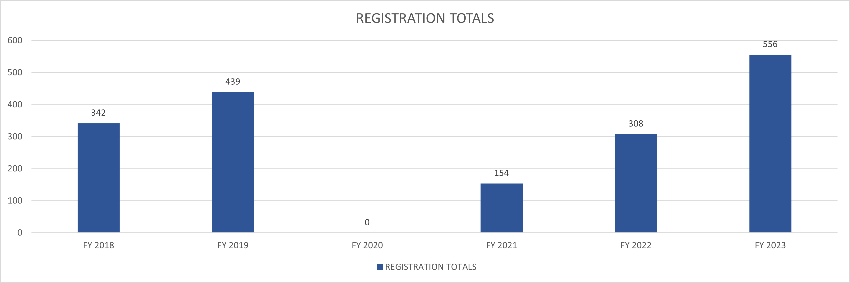
Supportive Data

Slide 9
FY 2025 Keep Doing
Statement: The College of Arts and Media plans to keep CAM emphasis on flexible models of instruction and modalities of delivery because students require supportive and flexible modalities of teaching (online, hybrid, term options) as appropriate to the course content. This action aligns with Strategy 1: Prioritize Student Success and Student Access and Goal 1.2 - Academic Agility and will have a positive impact to increase enrollments, retention, and completion in these flexible programs in achieving Pillar 1 - Enrollment.
Supporting Data:
Resources / Collaborations Required: Continued collaboration with SHSU Online to build out and support programs. Continued collaboration with Graduate Studies and IMC to market and promote graduate programs.

Slide 10
FY 2025 Stop Doing
Statement: The College of Arts and Media plans to stop providing free access to CAM public events except in strategic areas because additional revenue generated through CAM public events will increase support for student enrichment activities, including scholarships and programmatic student travel. This action aligns with Strategy 2: Embody a culture of excellence and Goal 2.6 - Revenue generation and optimization and will have increased investment in student enrichment funding to promote student degree satisfaction and expand the reputation of CAM's public performances in achieving Pillar 4 - Agility.
Supporting Data:
Resources / Collaborations Recovered:

Slide 11
FY 2025 Stop Doing
Statement: The College of Arts and Media plans to stop catering CAM events except to support essential goals because reducing this expenditure will redirect funding to support essential goals. This action aligns with Strategy 2: Embody a culture of excellence and Goal 2.2 - Align processes and resources, such as staffing, facilities, technology, and other assets to strategic priorities and provide funding to support essential goals in achieving Pillar 4 - Agility.
Supporting Data:
Resources / Collaborations Recovered:

Slide 12
FY 2025 Stop Doing
Statement: The College of Arts and Media plans to stop printing and mailing items and shift to digital distribution when appropriate and effective to do so because reducing this expenditure will allow CAM to redirect funding to support essential goals. This action aligns with Strategy 2: Embody a culture of excellence and Goal 2.2 - Align processes and resources, such as staffing, facilities, technology, and other assets to strategic priorities and will make additional funding available to support essential goals in achieving Pillar 4 - Agility.
Supporting Data:
Resources / Collaborations Recovered:

Slide 13
FY 2025 Start Doing
Statement: The College of Arts and Media plans to start and support a University Art Museum to exhibit the University Art collection and interface with the community as well as expand curricular offerings in art education, art history, and museum studies because the SHSU Art Museum will expand the reputation of the institution, connect with local and regional cultural institutions, and serve as a laboratory space with growing degree programs. This action aligns with Strategy 3: Elevate the reputation and visibility of SHSU and Goal 3.2 - Increase local, national, and international high-profile quality events hosted by SHSU and will have help build out a more visible and high-profile culture of philanthropy, service, and community engagement in achieving Pillar 4 - Agility.
Supporting Data:
Resources / Collaborations Required: Recent donor support will help build out this initiative.

Slide 14
College of Arts & Media
KEEP DOING
Summer Programming
Flexible Instruction Models
STOP DOING
Free Performance Tickets
Non-Essential Catering
Non-Essential Printing
START DOING
University Art Museum

Slide 15
Questions?

